Slide 1
Protection and
Security
in
OS

Slide 2
Introduction
Interference in resource utilization is a very serious threat in an OS
The nature of the threat depends on the nature of a resource and the manner in which it is used.
In this session, we discuss threats to information stored in files because they are the most common, and also the most complex, threats.
ν
ν
ν

Slide 3
Protection and
Security
ν
OS use two sets of techniques to
counter threats to information namely:
♦ Protection
♦ Security

Slide 4
Protection
ν
It involves guarding a user’s data and
programs against interference by other authorized users of the system.

Slide 5
Security
ν
It involves guarding of a user’s data
and programs against interference by external entities, e.g. unauthorized
persons.

Slide 6
Facets to protection of information
ν
There are two facets to protection of
information
♦ Secrecy: Implies that only authorized users should be able to access information.
♦ Privacy: Implies that information should be
used only for
intended and
OS focuses on
the purpose(s) for which it is
shared.
guaranteeing secrecy of
information , and leaves the issue of privacy
to the users and their processes.

Slide 7
Security and
Protection: Policies
and Mechanisms
Security
Policy
Specify whether a person can
become a user of the system. This function is performed by the system administrator
Mechanisms
1.
2.
Add or delete users
Verify whether a person is an authorized user.
Protection
Policy
Specify whether a user can
access a specific file. The owner of a file performs this function while creating it.
Mechanisms
1.
Set or change
protection information for a file.
Check whether a file can be accessed by a user.
2.

Slide 8
Security
Attributes
ν
Security is traditionally defined by the
three attributes namely:
♦ Confidentiality: It is the prevention of
unauthorized modification of information resources.
or
♦ Integrity: It is the prevention of unauthorized
♦ Availability: It is the prevention of
unauthorized withholding of information or resources.

Slide 9
Security
Threats
ν
Direct: This is any direct attack on your
specific systems, whether from outside hackers or from disgruntled insiders.
Indirect: This is general random attack, most commonly computer viruses, computer worms or Trojan horses.
ν

Slide 10
Reasons for taking Security
measures
ν
ν
ν
ν
ν
To
To
To
prevent
prevent prevent
loss of data
corruption of compromise
data
of data
TO prevent theft of data
To prevent sabotage

Slide 11
Authentication
ν
Goal of Authentication: Reasonable
assurance that anyone who attempts
to access a system or
legitimate user.
3 Mechanisms:
♦ Password
a network
is
a
ν
♦ Physical token or an artifact
♦ Biometric measure

Slide 12
Security
Models
ν
Security models can be discretionary or
mandatory.
♦ Discretionary: Holders of right can be
allowed to transfer them at their discretion.
♦ Mandatory: Only designated roles are
allowed to grant rights and users cannot transfer them.

Slide 13
Security policy Vs. Security Model
ν
Security Policy: Outlines several high
level points: how the data is accessed, the amount of security required and what are
the steps when these requirements are not met.
Security Model: The mechanism to
support the security policy. This involves
in the design of the security system.
ν

Slide 14
Access
Matrix Model
ν
Consists
three principal components:
passive objects (files, terminals, and other entities)
active subjects, which may be
♦ A
set of
devices
♦ A
set of
manipulate the objects
♦ A
set of rules governing the manipulation
of objects by subjects.

Slide 15
^{ν}The access matrix is a rectangular array
with one row per
per object.
subject and
one
column
Objects
File
1
File
2
File 3
Subjects
User
1
r,w
r
r,w,x
User
2
r
r
r,w,x
User
3
r,w,x
r,w
r,w,x

Slide 16
Role
Based
Access Control
ν
Enforces access controls depending upon
a user role(s).
Roles represent specific organization duties and are commonly mapped to job title. Ex: Administrator, Developer etc.
Role definitions and associated access rights must be based upon a thorough understanding of an organization’s security policy.
ν
ν

Slide 17
Take-Grant
Model
ν
This model use graphs to model access
control.
The graph structure can be represented as an adjacency matrix and labels on the arcs can be coded as different values in the matrix.
Nodes in the graph are of two types, one corresponding to subjects and the other to objects.
The possible access rights are read( r), write(w), take(t) and grant(g).
ν
ν
ν

Slide 18
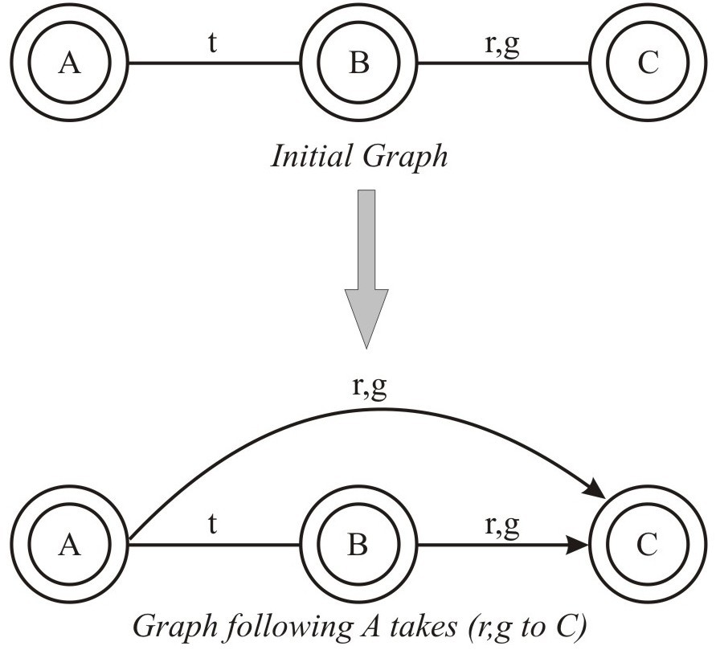
Example
of
Take

Slide 19
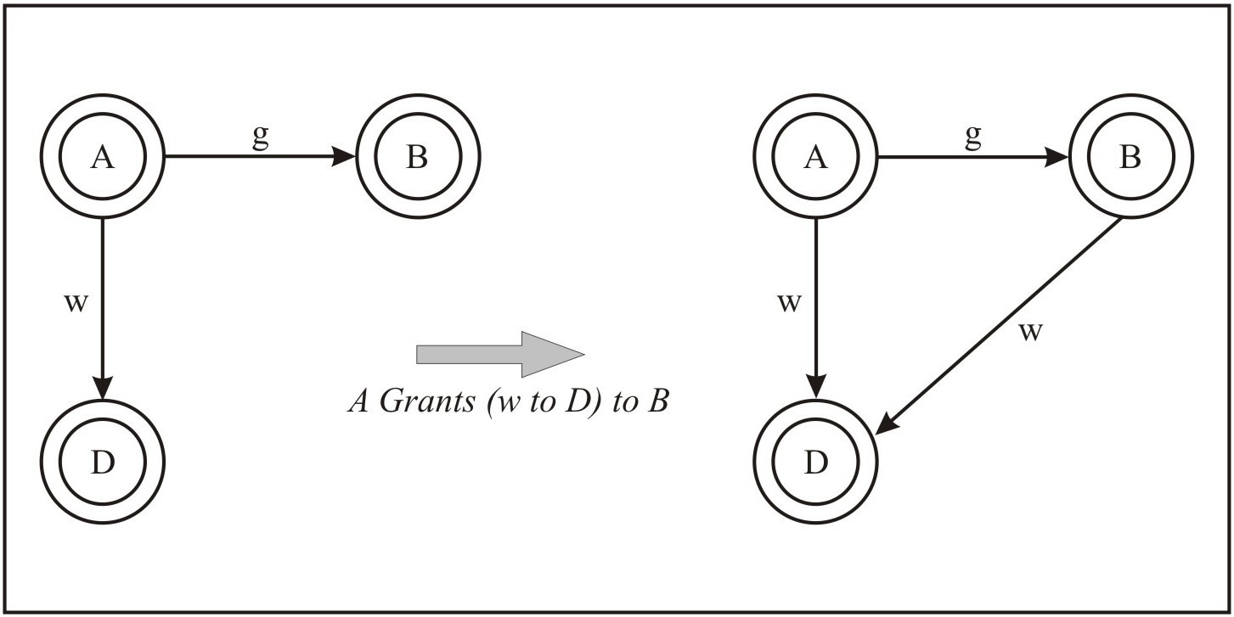
Example
of
Grant

Slide 20
Multilevel
Models
ν
This type of models corresponds to the
multilevel policies where data is classified into sensitivity levels and users have access according to their clearances.
Also known as Data Flow Models.
ν

Slide 21
Contd…
ν
The Bell-La Padula model, intended to
contral leakage of information between levels.
The Biba Model, which controls the integrity.
The Lattice Model, which generalizes the partially ordered levels of the previous models using the concept of mathematical lattices.
ν
ν

Slide 22
Thank
You

